Slide 1
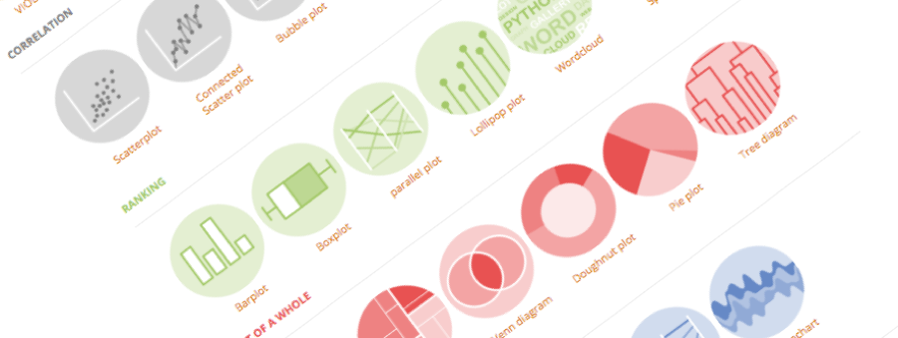

A project by Yan Holtz and Conor Healy
A classification of chart types based on input data format
DataViz Meetup | Sydney | November 2018

Slide 2

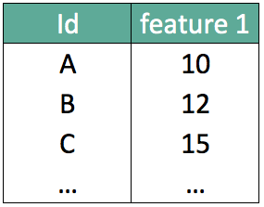
What should I do with my data ??

Slide 3
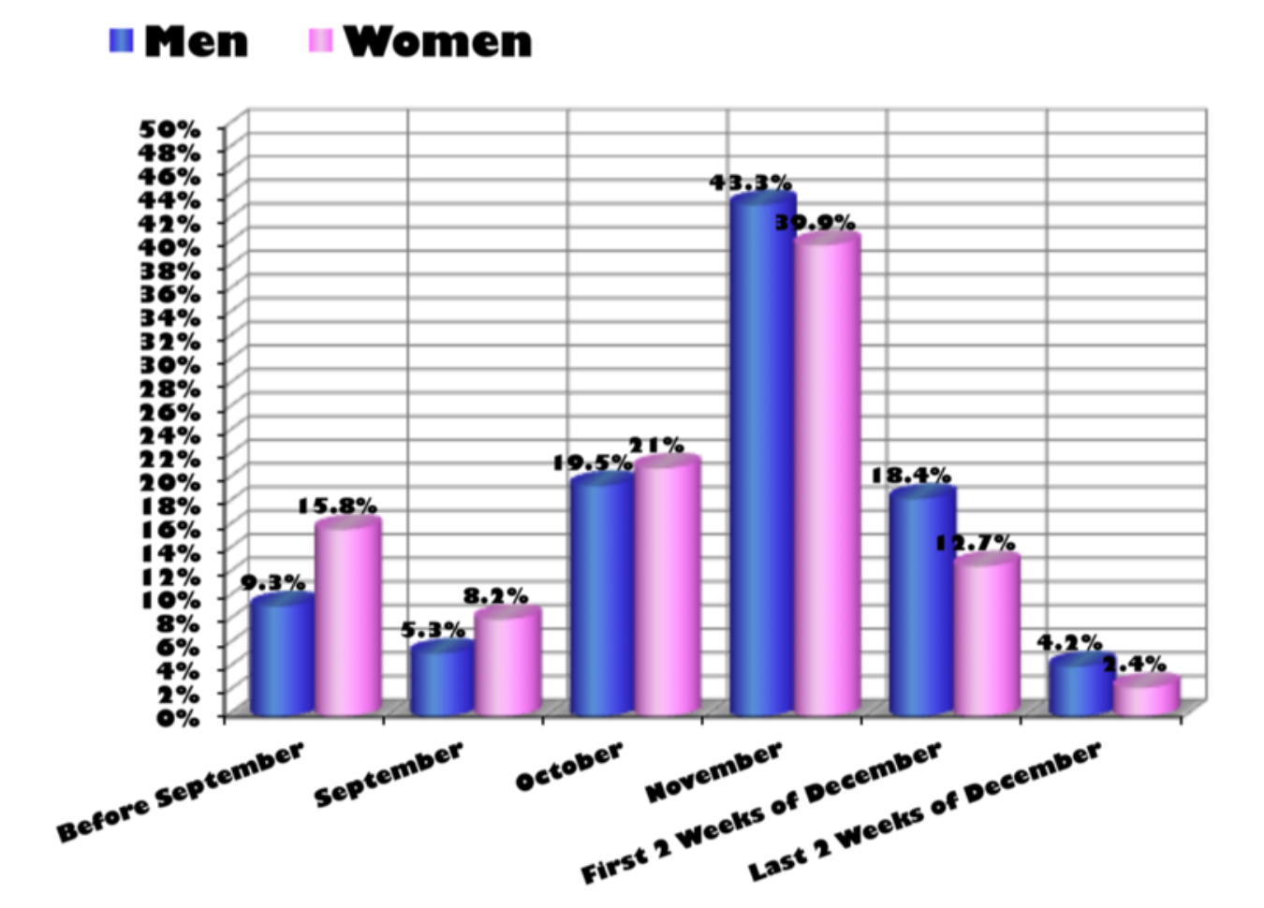
…
What about that?
Source: Storytelling with data by Cole Nussbaumer Knaflic

Slide 4
Looking for a chart ?
What you can do
What you should do
Caveats to avoid
How to
build it

Slide 5
WHAT YOU CAN DO
A classification of chart types based on data input format

Slide 6
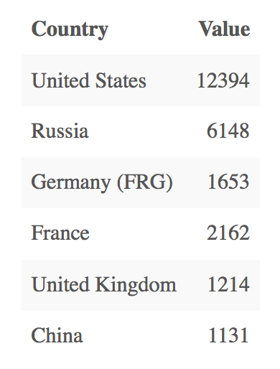
Who sells more weapons ?
?
Notes:
Very simple dataset,
-> What would you do ?

Slide 7
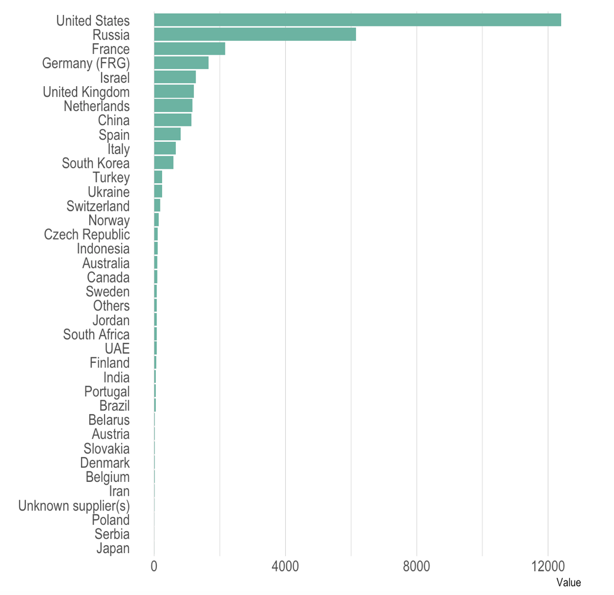
Who sells more weapons ?

Slide 8
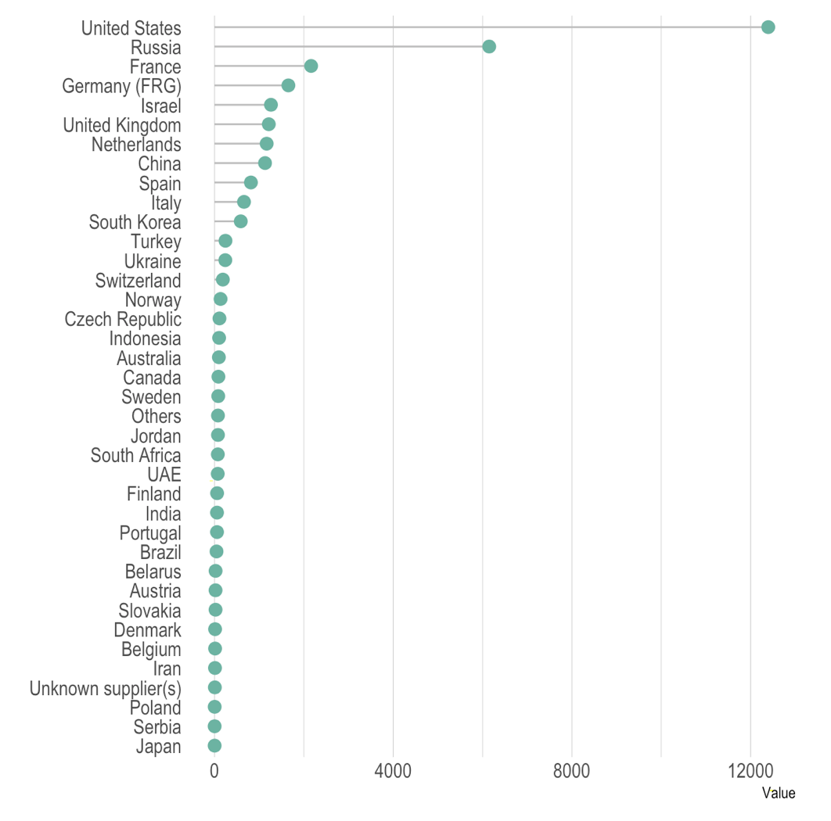
Who sells more weapons ?

Slide 9
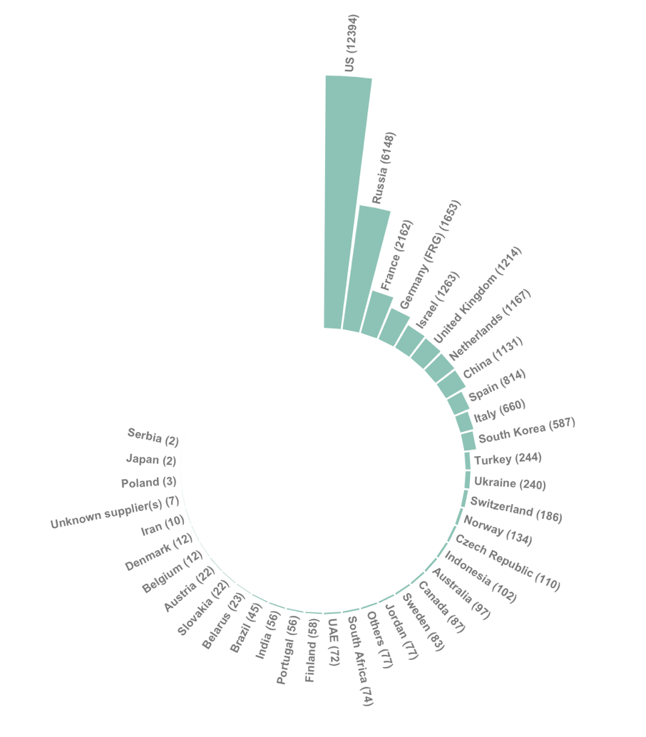
Who sells more weapons ?

Slide 10
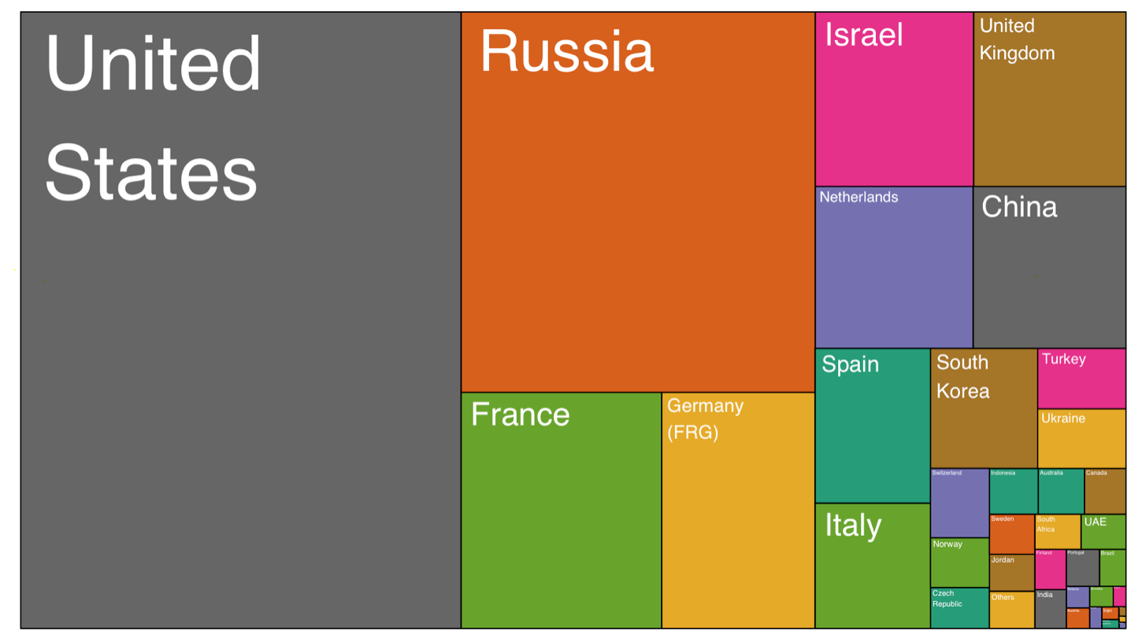
Who sells more weapons ?

Slide 11
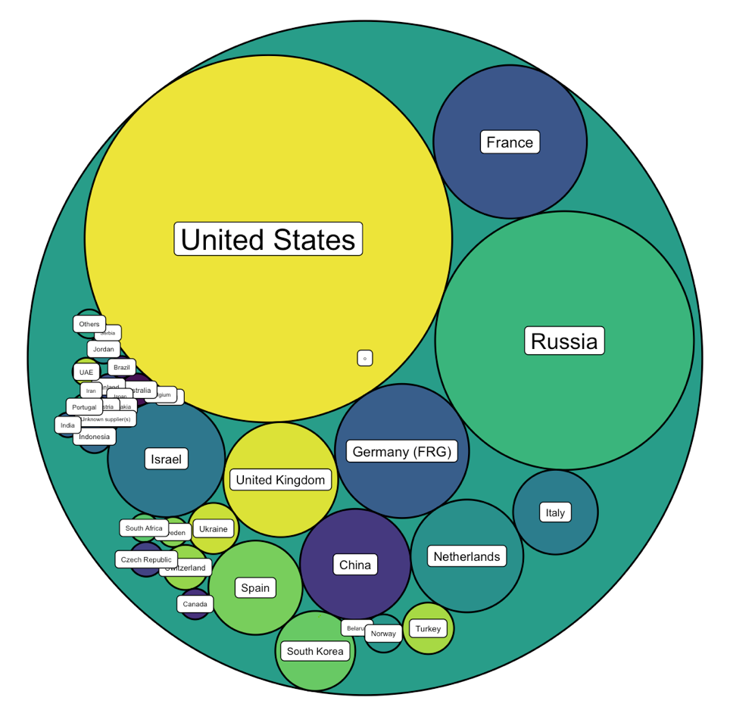
Who sells more weapons ?

Slide 12







Who sells more weapons ?

Slide 13
Who sells more weapons ?
1 observation per group
1 categorical variable
1 numerical variable

Slide 14
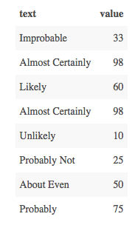
Perception of probability

Slide 15
Perception of probability
Several observations per group
1 categorical variable
1 numerical variable

Slide 16
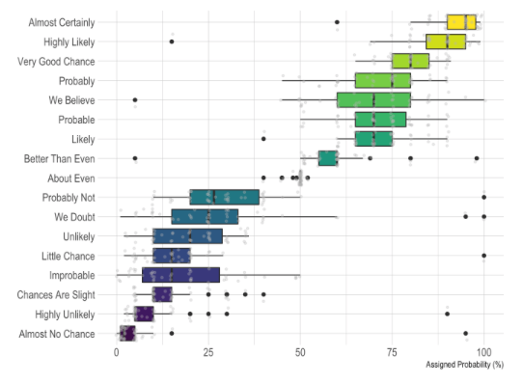
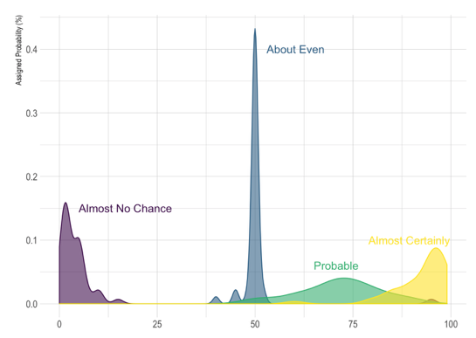
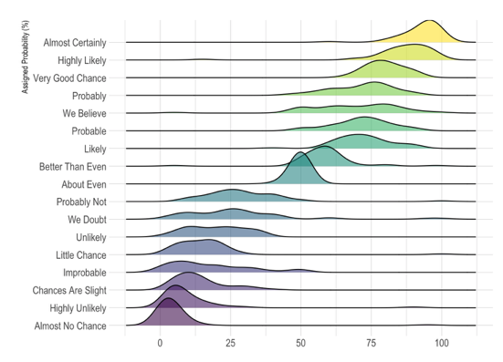
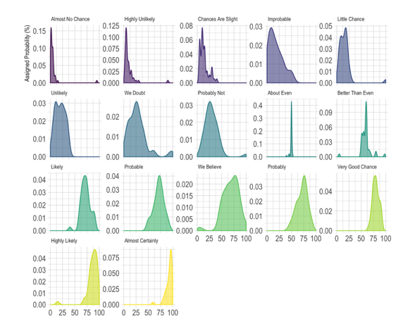
Perception of probability
Several observation per group
1 categorical variable
1 numerical variable

Slide 17
So…
Knowing the possibilities is the first step in chart choice
Not easy to know all the chart types
Hard to figure out options from a dataset
Let’s built a decision tree

Slide 18
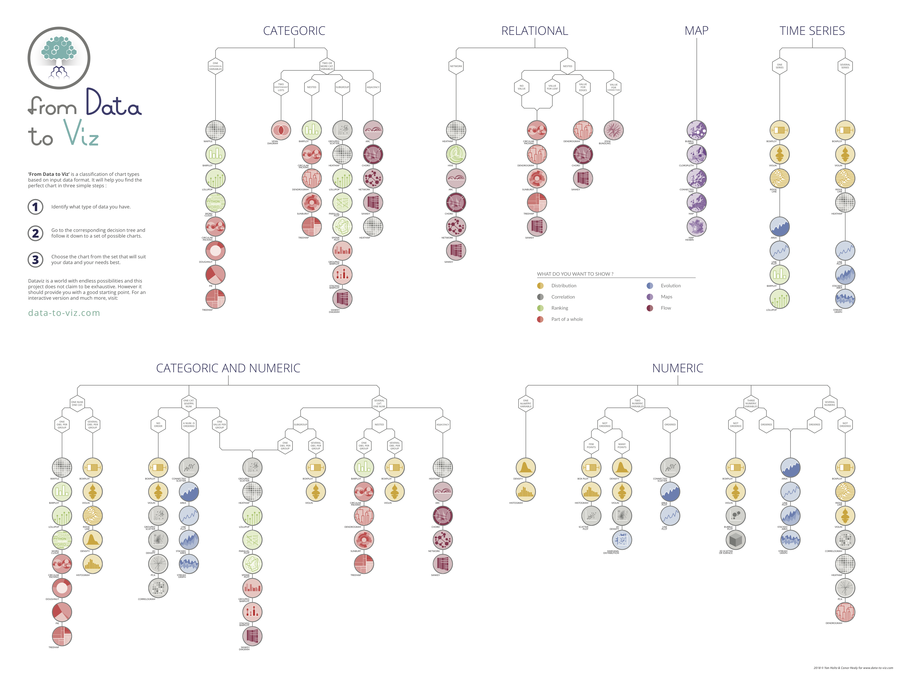
Notes:
+ WEBSITE DEMO

Slide 19
WHAT YOU SHOULD DO
About 20 examples of storytelling with data

Slide 20
Who’s reading ?
Interactive or Static?
Data itself
Chart Decision
Eye catching / accurate
Question
Exploratory vs Explanatory

Slide 21
Stories Online example
Notes:
Show that code is available

Slide 22
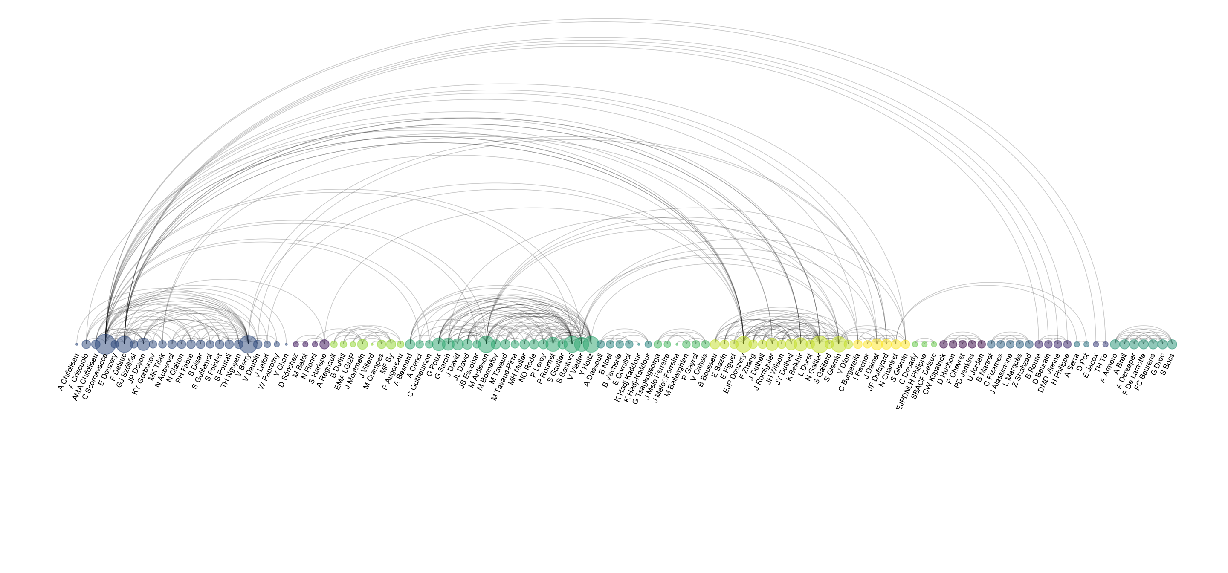
Co-authorship network of a researcher

Slide 23
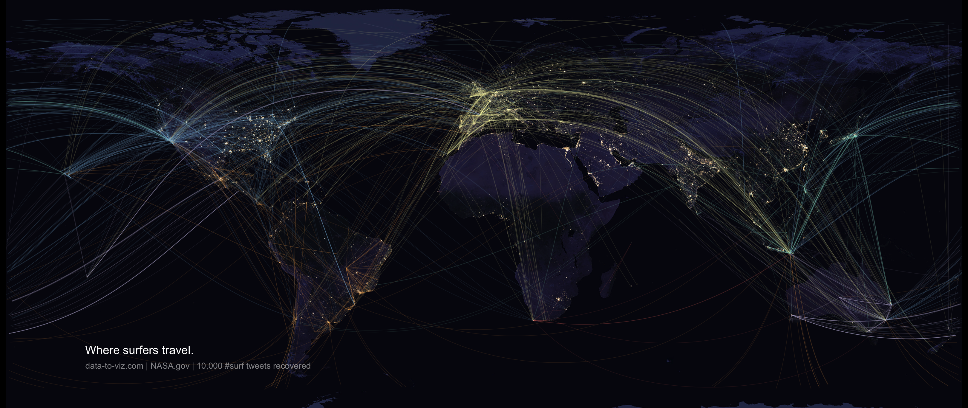

Slide 24
WHAT YOU SHOULD NOT DO
A gallery of most common caveats

Slide 25
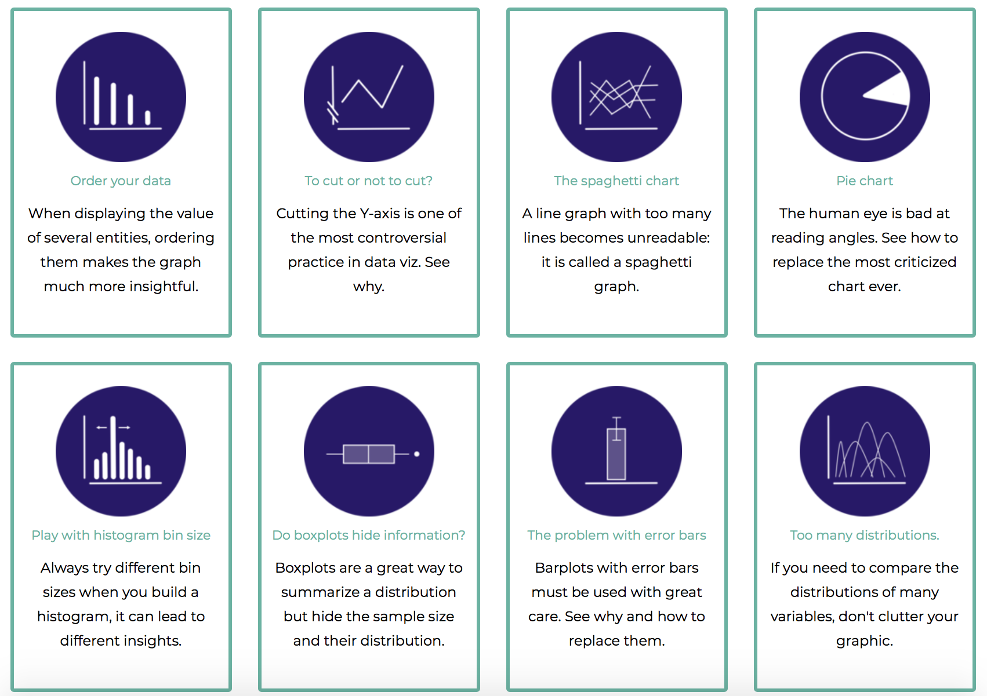

Slide 26
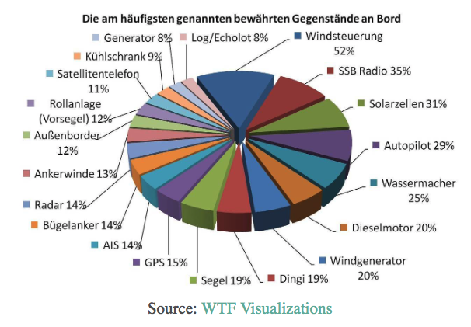
Calculation error and more

Slide 27
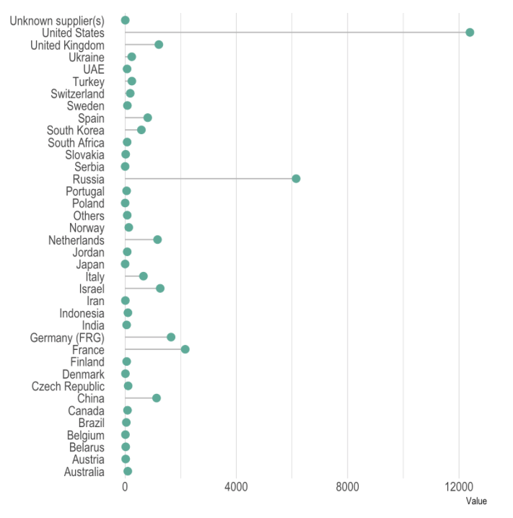
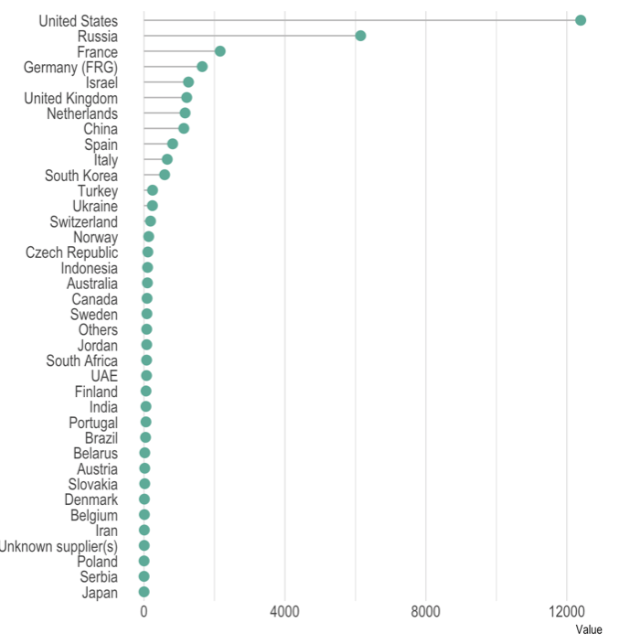
Order your data

Slide 28
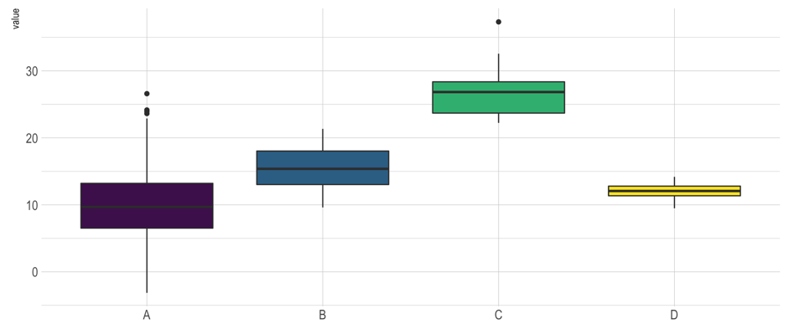

Slide 29
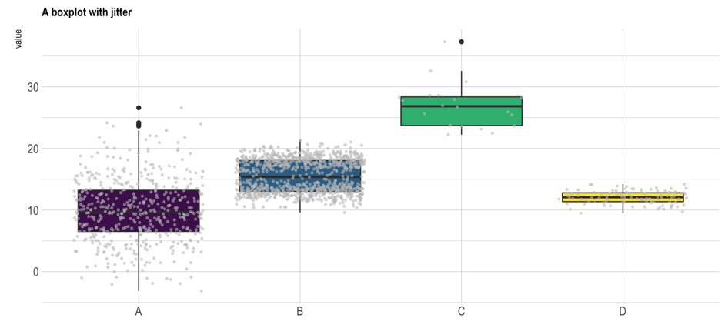
The issue with boxplot
Read more

Slide 30
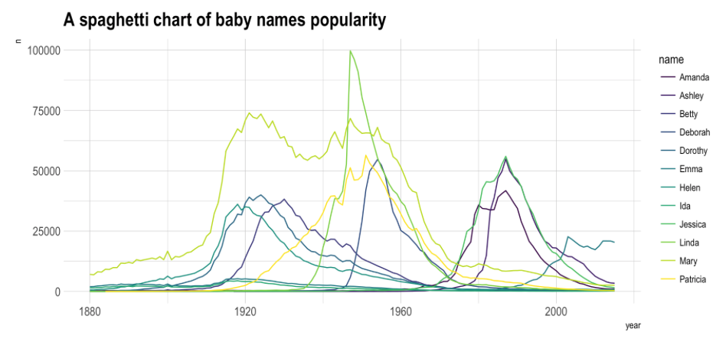

Slide 31
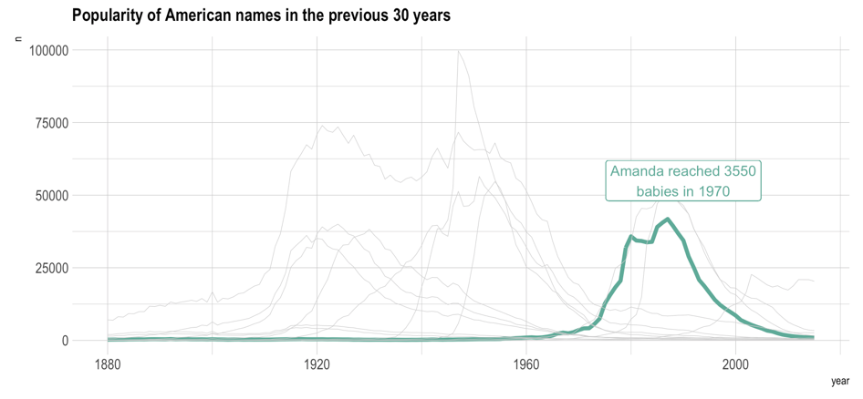
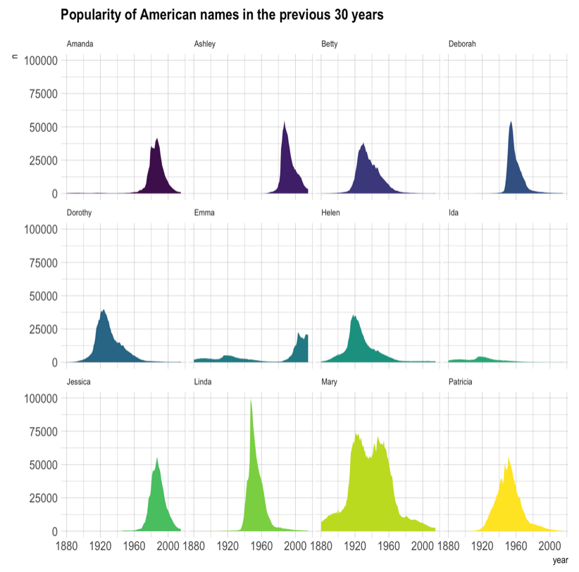
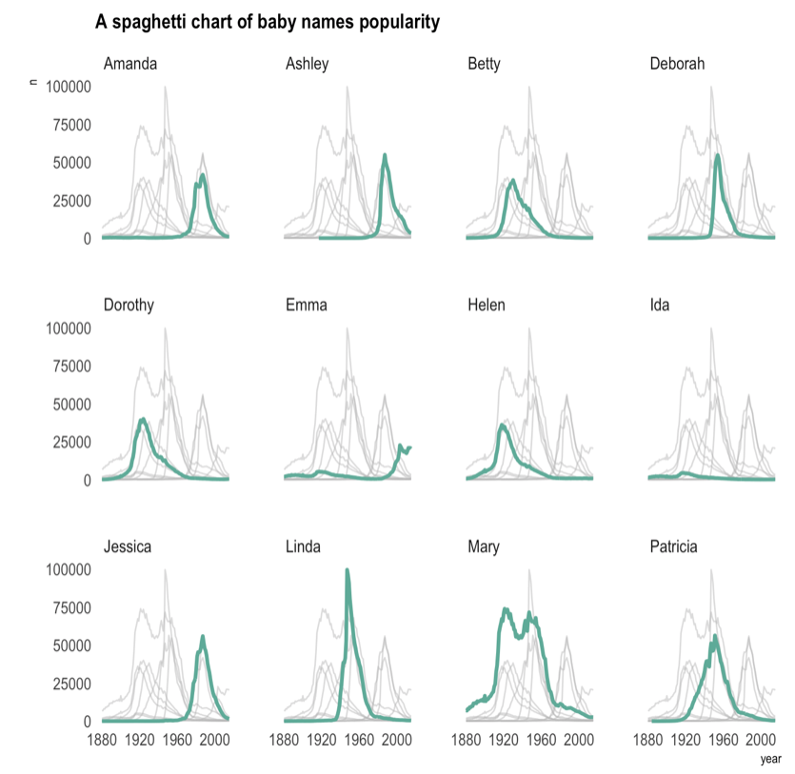
The Spaghetti chart
Read more

Slide 32
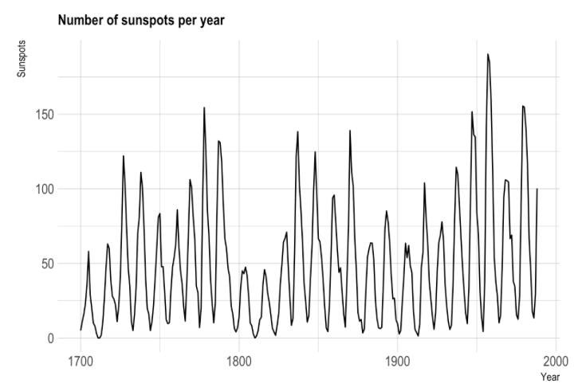

Slide 33
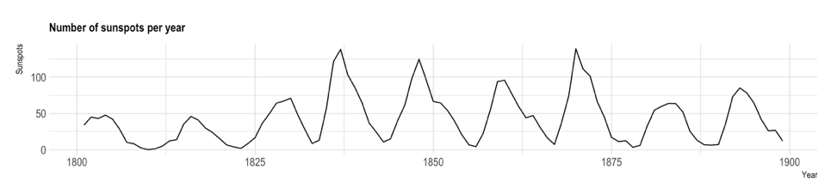
Mind the aspect ratio
Read more

Slide 34
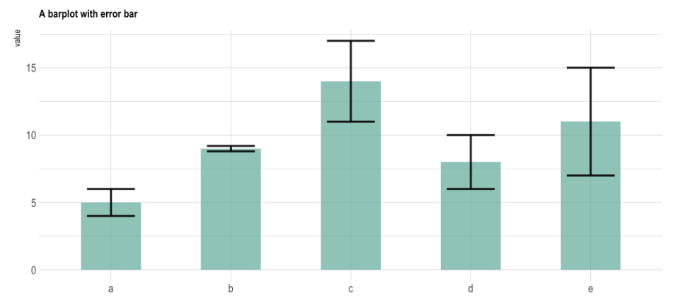

Slide 35
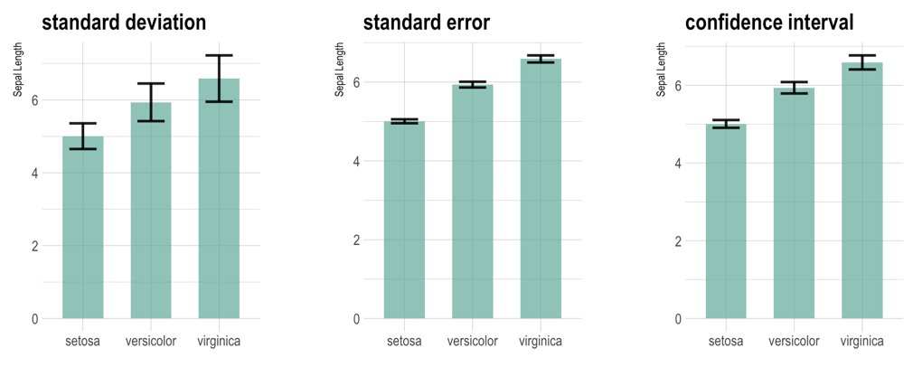
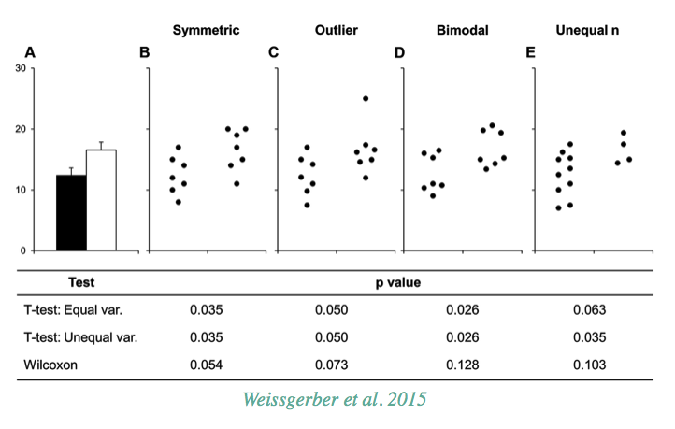
The issue with error bars
Read more

Slide 36
HOW TO DO IT
The R and Python graph galleries

Slide 37
See the chart maker directory by visualisingdata.com
Data Wrapper
R
Flourish
Python
Tableau
SAS
Jump
MatLab
Excel
QlikView
Julia
D3
Easy
Limited
Hard
Flexible
* Far from being exhaustive

Slide 38


R-graph-gallery.com
Python-graph-gallery.com
D3-graph-gallery.com

Slide 39





Data-to-viz.com
@R_Graph_Gallery
github.com/holtzy/Talk
Yan.holtz.data@gmail.com
www.yan-holtz.com

